Slide 1
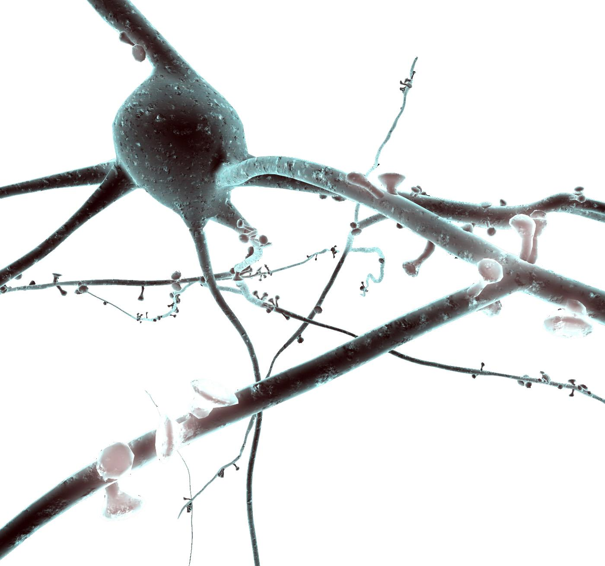
Using NEURON to model cells Tutorial
Oren Amsalem and Yoni Leibner
oren.amsalem1@mail.huji.ac.il, yoni.leibner@mail.huji.ac.il
Idan Segev Lab
https://github.com/YoniLeibner/EITN_spring_school.git
https://github.com/orena1/NEURON_tutorial

Slide 2
Introduction
Read More About NEURON
The NEURON Simulation Environment is designed for modeling individual neurons and networks of neurons.
It is particularly well-suited to explore problems which are closely linked to experimental data.
NEURON was build and is maintained by Ted Carnevale and Michael Hines, lately the Blue Brain Project is becoming heavily involved with the development of the software
Neuron is written in C & C++, the interface with the simulator is with HOC, but a python wrapper was build and now commonly used instead of HOC (NEURON is used as a python package). In addition User-defined mechanisms such as voltage- and ligand-gated ion channels are used in order to expand NEURON (mod files, need to be compiled).
In this presentation I will show the following examples:
Single compartment model
Ball and Stick model and a replication of a published result (Gidon et al.)
Layer 5 Pyramidal cell and two replications of published results (Hay et al., Doron et al.)
This presentation is accompanied with jupyter notebooks which contain the complete code of each example - https://goo.gl/pke4hk (nrnivmodel mods)

Slide 3
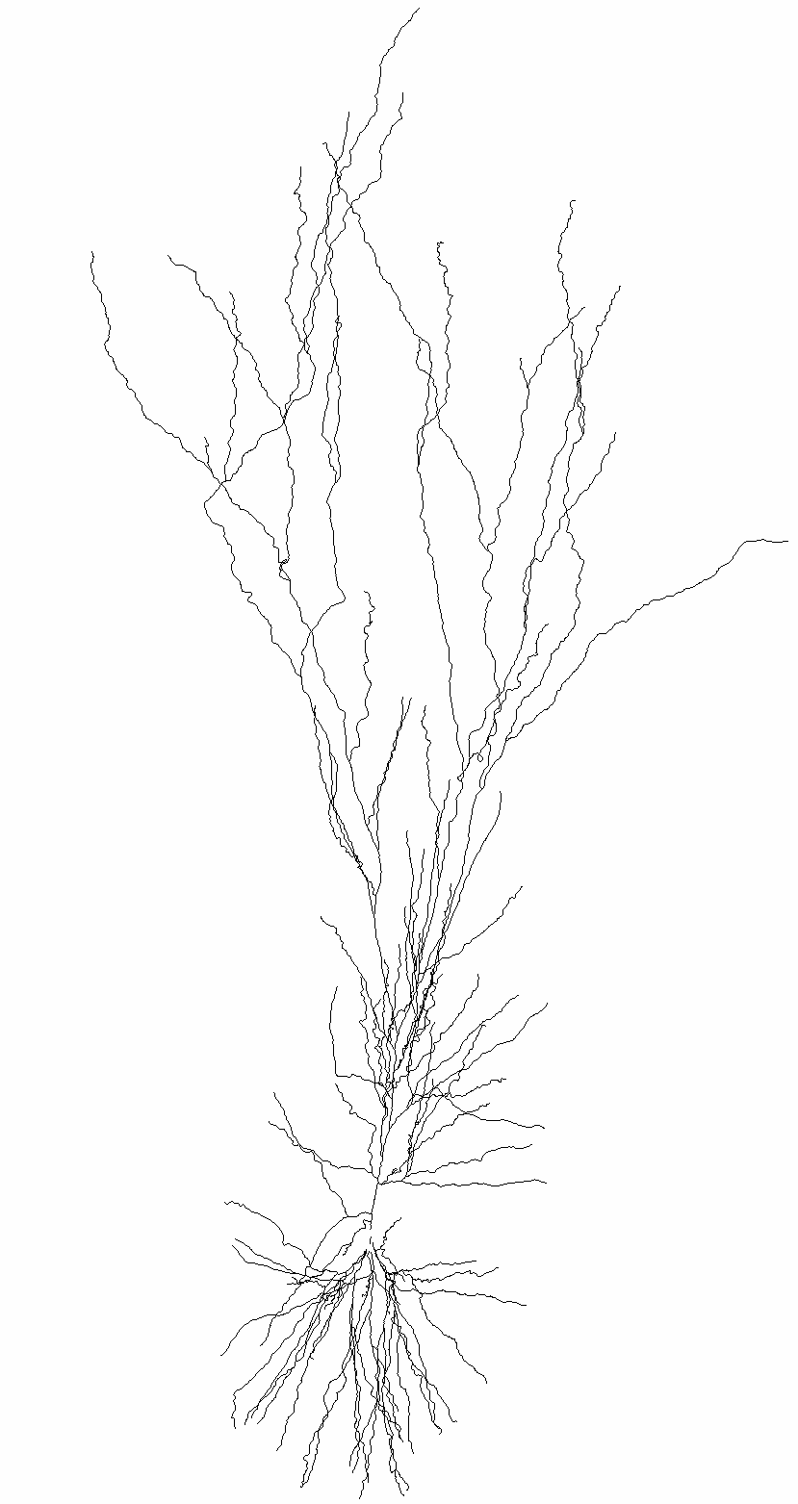
Introduction
Read More About NEURON
basic concepts of Neuron models:
Model - a Neuron object, it can have soma, basal dendrites (dend) and apical dendrite (apic).
Section - more of a morphological definition, a section is usually a dendrite between 2 bifurcation points.
Segment - one RC circuit that resemble (approximate) the computation in a peace of membrane.
clamps - an object that represent an experimental electrode.
Synapses - object that resemble a single synapse (we will see it later, and how it’s activated in the simulation).
Point Process - a more general idea, it’s an object that seats on the segment (RC circuit), and simulate a channel or synapse.

Slide 4
Introduction - object oriented programming
in every programing language, there are build in object: int, float string char etc.
in object oriented programming, we can choose to create new objects that will have new properties, like to create current clamp that will have an float parameter for amplitude.
in the computer this makes a new idea on pointers. the idea is that the data is saved somewhere and i can access it if i now where it is.
Encapsulation: in other coding languages, some of the data is not publicly available, and it’s says, it’s private, we can access the data only from the object itself.
in neuron there is a game with pointers that we need to do sometime in order to get some data that is not “public”, like the section parent or childrens.

Slide 5
NEURON GUI introduction
let's start to know the GUI

Slide 6
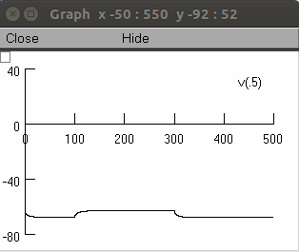
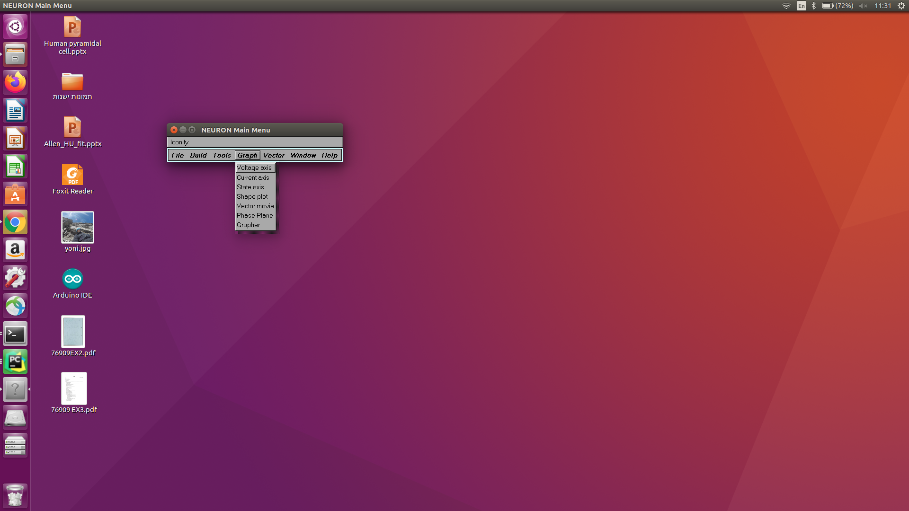
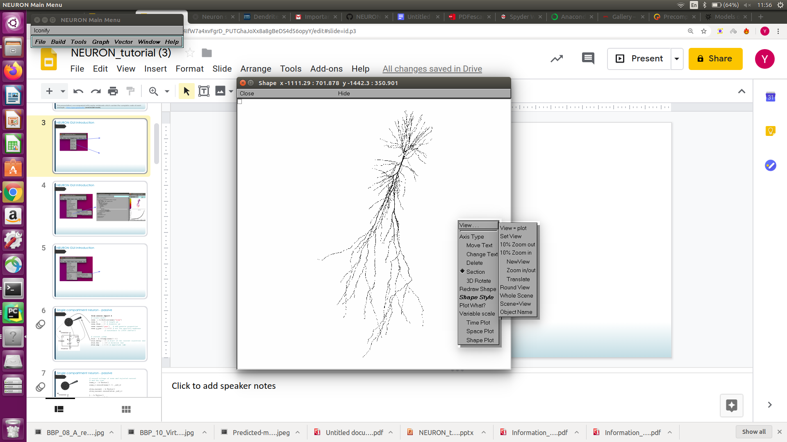
NEURON GUI introduction - basic graphs
after loading/ creating a model in neuron we can get basic graphs on the morphology we have and the voltage in the simulation.
right mouse click on the graph will open a menu that will allow as to change some of the graph properties.
get_to_know_the_gui

Slide 7
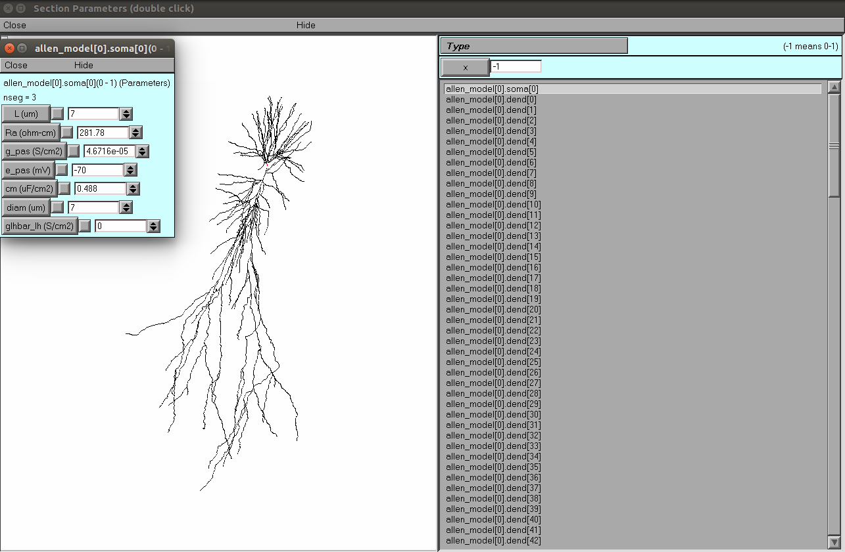
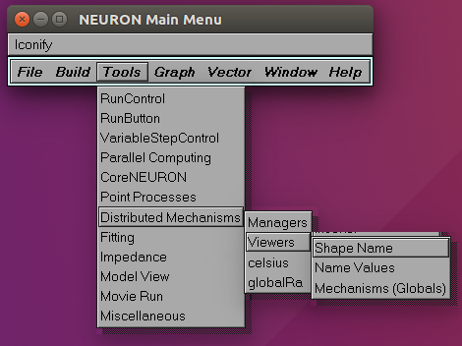
NEURON GUI introduction - data on sections
in order to better understand the morphology and its naming in Neuron, we can open a viewer of all model sections.
clicking on a section from the list will color the ection in red, and clicking on section will target the corresponding section in the list.
double click on a section, from the list, will open the section parameters.

Slide 8
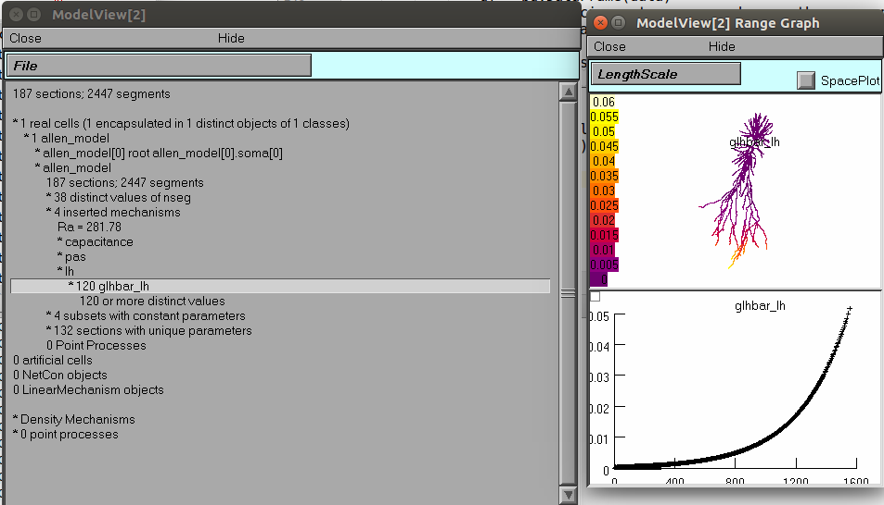
NEURON GUI introduction - general model view
in order to get a full view on the model we can go to model view.

Slide 9
let's get started

Slide 10
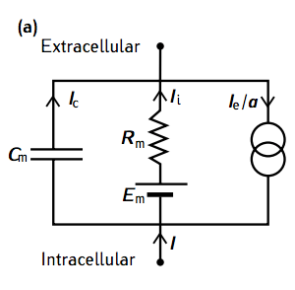
Single compartment neuron - single RC circuit, passive
from neuron import h
# create model
soma = h.Section(name="soma")
soma.L = 10 # length µm
soma.diam = 10 # diameter µm
soma.insert('pas') # add passive properties
soma.g_pas = 1/10000 # set the specific membrane
# resistance to 10000 ohm*cm^2
# current clamp
stim = h.IClamp(soma(0.5))
stim.delay = 20 # start of the current injection (ms)
stim.dur = 100 # duration (ms)
stim.amp = 0.01 # amplitude (nA)
Single_compartment_neuron_passive
Notes:
the goal here is to see how simple RC circuit is behaving

Slide 11
Single compartment neuron - single RC circuit, passive
running the first simulation
# record voltage of some and injected current
# and the time
soma_v = h.Vector()
soma_v.record(soma(0.5)._ref_v)
stim_current = h.Vector()
stim_current.record(stim._ref_i)
t = h.Vector()
t.record(h._ref_t)
# run simulation
h.tstop = 220 # set the simulation time
h.dt = 0.025
h.v_init = -70
h.run()
Notes:
Exercise:
Inject different currents to the neuron and create a figure like this one: http://www.jneurosci.org/content/jneuro/21/3/1067/F8.large.jpg

Slide 12
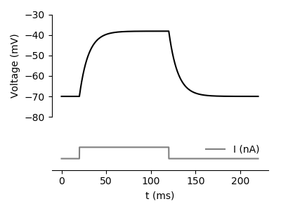
Single compartment neuron - single RC circuit, passive
running the first simulation - plotting the results
# plotting
f, (ax0, ax1) = plt.subplots(2,1, gridspec_kw = {'height_ratios':[3, 1]})
ax0.plot(t,soma_v, 'k')
ax1.plot(t,stim_current, 'gray', label='I (nA)')
Notes:
Exercise:
Inject different currents to the neuron and create a figure like this one: http://www.jneurosci.org/content/jneuro/21/3/1067/F8.large.jpg

Slide 13
Single compartment neuron - single RC circuit, passive
creating an I-V curve
from neuron import h, gui
import numpy as np
import matplotlib.pyplot as plt
# create model
soma = h.Section(name="soma")
soma.L = 10 # length ?m
soma.diam = 10 # diameter ?m
soma.insert('pas') # add passive properties
soma.g_pas = 1/10000.0 # set the specific membrane
# current clamp
stim = h.IClamp(soma(0.5))
stim.delay = 20 # start of the current injection (ms)
stim.dur = 100 # duration (ms)
h.tstop = 220 # set the simulation time
h.dt = 0.025
h.v_init = -70
Notes:
Exercise:
create an I-V curve for this model

Slide 14
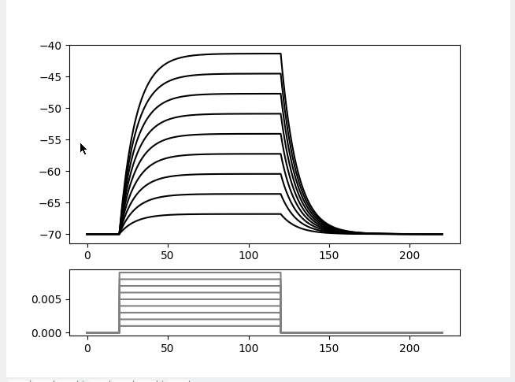
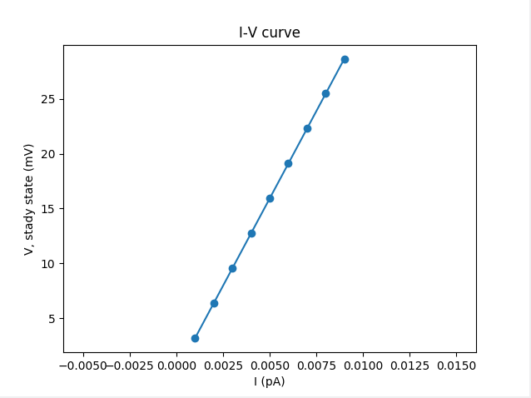
Single compartment neuron - single RC circuit, passive
creating an I-V curve
f, (ax0, ax1) = plt.subplots(2,1, gridspec_kw = {'height_ratios':[3, 1]})
inj_currents = []
stady_state_voltage = []
for amp in np.arange(0.001, 0.01, 0.001):
soma_v = h.Vector()
soma_v.record(soma(0.5)._ref_v)
stim_current = h.Vector()
stim_current.record(stim._ref_i)
stim.amp = amp
h.run()
t = np.arange(0, len(stim_current) * h.dt, h.dt)
ax0.plot(t, soma_v, 'k')
ax1.plot(t, stim_current, 'gray', label='I (nA)')
# data for I-V curve
inj_currents.append(amp)
stady_state_voltage.append(np.array(soma_v)[int(100.0/h.dt):int(120.0/h.dt)].mean() + 70)
plt.show()
# plotting the I-V curve
plt.figure()
plt.scatter(inj_currents, stady_state_voltage)
P = np.polyfit(inj_currents, stady_state_voltage, 1) # linear fit
plt.plot(inj_currents, np.array(inj_currents) * P[0])
Notes:
Exercise:
create an I-V curve for this model
we can look on the polinomial fit and see the input resistance we found in P[0].

Slide 15
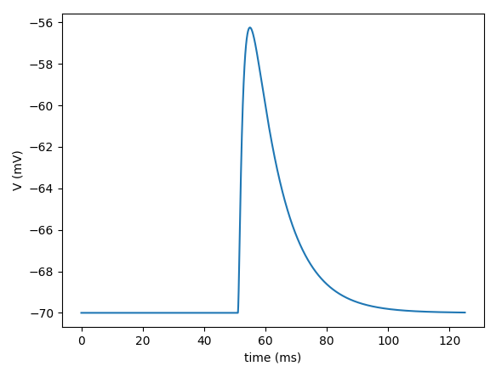
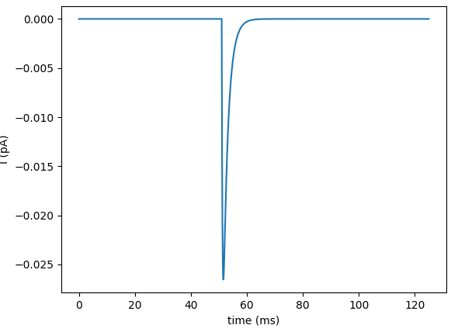
Single compartment neuron - single RC circuit, passive
adding synapses
# add a synapse
synapse = h.Exp2Syn(soma(0.5))
synapse.tau1 = 0.3
synapse.tau2 = 1.8
stim=h.NetStim()
stim.number = 1
stim.noise = 0 # no noise
stim.interval = 1
net_con = h.NetCon(stim, synapse)
net_con.weight[0]= 0.0004 # the maximal conductance of the synapse
# record
soma_v = h.Vector() # set up a recording vector
soma_v.record(soma(0.5)._ref_v) # record voltage at the middle of the soma
synapse_i = h.Vector() # set up a recording vector
synapse_i.record(synapse._ref_i) # record the current in the synapse
# run
h.v_init = -70 # set starting voltage
h.tstop = 125 # set simulation time
h.run() # run simulation
# plot the results
Notes:
reversal potential
Exercise: what will happen if the e_pas was 0? repeat with e_pas = 0 and v_init = 0 (mV)

Slide 16
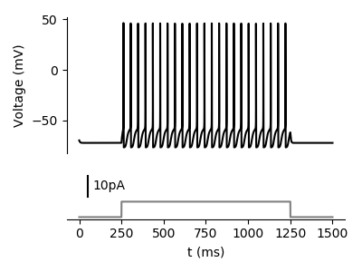
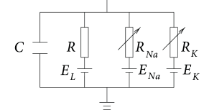
Single compartment neuron - single RC circuit, active
soma = h.Section(name="soma")
soma.L = 10
soma.diam = 10
soma.insert('pas') # add passive properties
soma.g_pas = 1/10000 # set the specific membrane resistance # to 10000 ohm*cm^2
soma.insert('kv') # add potassium channel
soma.gbar_kv = 2000 # set the potassium conductance (pS/um2)
soma.insert('na') # add sodium channel
soma.gbar_na = 8000 # set the sodium conductance
h.celsius = 30 # set temperature
# current clamp
stim = h.IClamp(soma(0.5))
stim.amp = 0.007446
Single_compartment_neuron_active
Notes:
Exercise:
Inject different currents and check what is the IF curve: http://www.jneurosci.org/content/jneuro/23/37/11628/F1.large.jpg

Slide 17
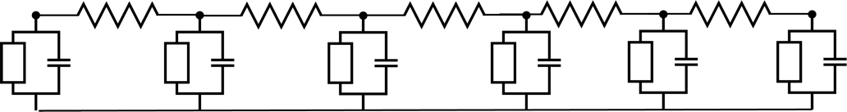
moving to the cable model
###################
# # Build Model # #
###################
dend = h.Section(name="dend")
dend.L = 500 # um
dend.diam = 1 # um
dend.Ra = 100 # ohm*cm
dend.insert('pas')
dend.g_pas = 1/10000
h("forall { nseg = int((L/(0.1*lambda_f(100))+0.9)/2)*2 + 1 }") # set the number
#of segments
Dendrite
dend(0.1).v
nseg = 6
dend(0.4).v
d_lambda rule – NEURON book p50
cable_model

Slide 18
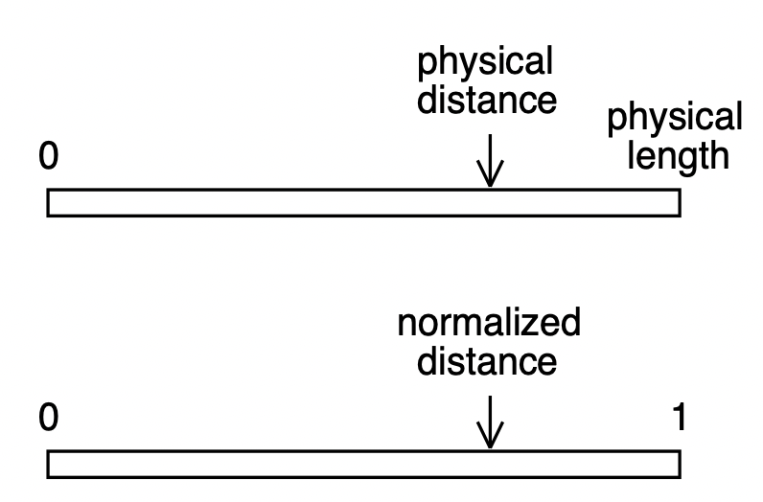
Section and segments
Example:
Length of a section named dend is 10 µm, if we want to examine the voltage at location which is after 7 µm from point 0, we should do: dend(0.7).v
Also if the length of the section is 100 µm and we want to examine location 70 µm we would write dend(0.7).v
Dendrite

Slide 19
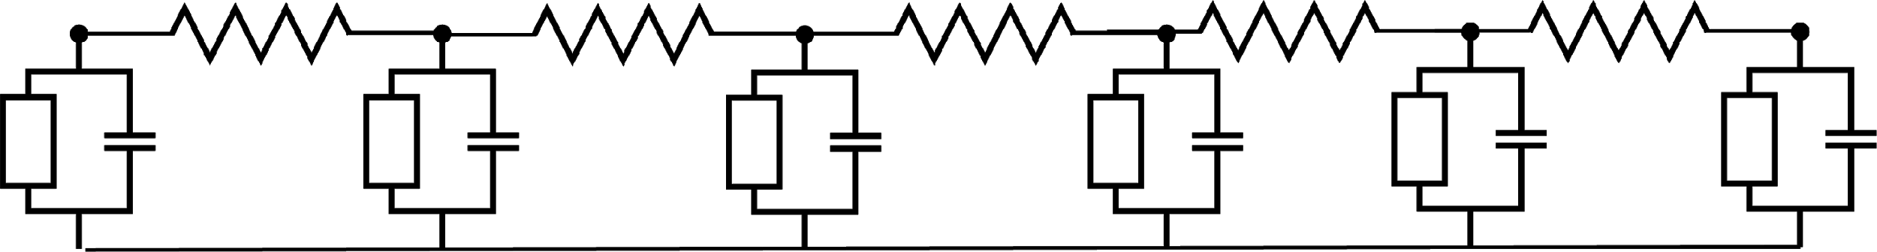
voltage travel in the cable
synaptic input
Dendrite
# add a synapse
synapse = h.Exp2Syn(dend(1))
synapse.tau1 = 0.3
synapse.tau2 = 1.8
stim=h.NetStim()
stim.number = 1
stim.noise = 0 # no noise
stim.interval = 1
net_con = h.NetCon(stim, synapse)
net_con.weight[0]= 0.0004

Slide 20
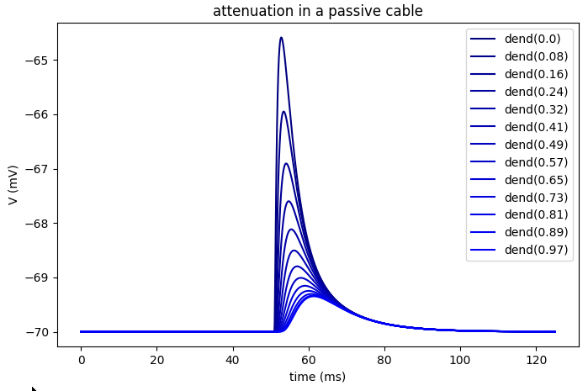
voltage travel in the cable
# set_recording
dend_vs = []
for seg in dend:
dend_vs.append(h.Vector())
dend_vs[-1].record(seg._ref_v)
# run the simulation
t = h.Vector()
I = h.Vector()
I.record(synapse._ref_i)
t.record(h._ref_t) #record time.
h.v_init = -70 # set starting voltage
h.tstop = 125 # set simulation time
h.run() # run simulation
# plot the results
plt.figure(figsize=(8,5))
for i,v in list(enumerate(dend_vs))[::3]:
plt.plot(t, v, color=(0,0,0.5+0.5*i/len(dend_vs)),
label = 'dend('+str(round(i/len(dend_vs), 2))+')')
plt.xlabel("time (ms)")
plt.ylabel("V (mV)")
plt.title("attenuation in a passive cable")

Slide 21
Ball and Stick model - forward propagation
###################
# # Build Model # #
###################
soma = h.Section(name="soma")
soma.L = 10 # um
soma.diam = 10 # um
soma.Ra = 100
soma.insert('pas')
soma.g_pas = 1/10000 # 1/Rm - Rm ohm*cm^2
dend = h.Section(name="dend")
dend.L = 500 # um
dend.diam = 1 # um
dend.Ra = 100 # ohm*cm
dend.insert('pas')
dend.g_pas = 1/10000
h("forall { nseg = int((L/(0.1*lambda_f(100))+0.9)/2)*2 + 1 }") # set the number
#of segments
Soma
Dendrite
synaptic input
R_{s}
R_{d3}
R_{d0}
dend.connect(soma, 1, 0) #connect the end of the soma
#to the start of the dendrite
Notes:
here the difference is that there is a capacitance sink in the soma that make the cable non-even, and will affect the forward vs backward propagation

Slide 22
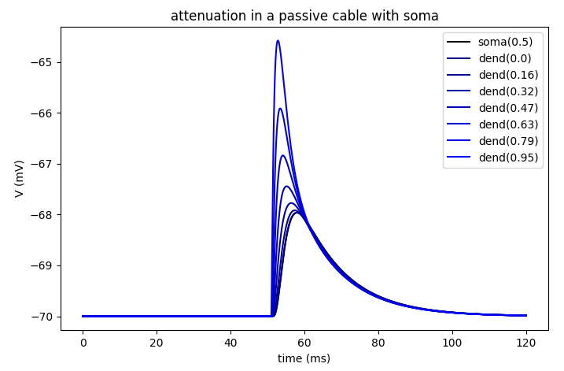
Ball and Stick model - run the synapse again
#########################
# # Set up experiment # #
#########################
# add a synapse
synapse = h.Exp2Syn(dend(1))
synapse.tau1 = 0.3
synapse.tau2 = 1.8
stim=h.NetStim()
stim.number = 1
stim.noise = 0 # no noise
stim.interval = 1
net_con = h.NetCon(stim, synapse)
net_con.weight[0]= 0.0004
soma_v = h.Vector() # set up a recording vector
soma_v.record(soma(0.5)._ref_v) # record voltage at the #middle of the soma
# Record voltage from all segments in the dendrite
dend_vs = []
for seg in dend:
dend_vs.append(h.Vector())
dend_vs[-1].record(seg._ref_v)
t = h.Vector()
t.record(h._ref_t) #record time.
h.v_init = -70 # set starting voltage
h.tstop = 200 # set simulation time
h.run() # run simulation
Notes:
the current prefer to go to the soma, where we have a capacitance sink (low resistance)

Slide 23
Ball and Stick model - forward propagation in steady state
#########################
# # Set up experiment # #
#########################
stim = h.IClamp(h.soma(0.5)) # add a current clamp the # the middle of the soma
stim.delay = 10 # ms
stim.dur = 100
stim.amp = 0.1 # nA
soma_v = h.Vector() # set up a recording vector
soma_v.record(soma(0.5)._ref_v) # record voltage at the #middle of the soma
# Record voltage from all segments in the dendrite
dend_vs = []
for seg in dend:
dend_vs.append(h.Vector())
dend_vs[-1].record(seg._ref_v)
t = h.Vector()
t.record(h._ref_t) #record time.
h.v_init = -70 # set starting voltage
h.tstop = 120 # set simulation time
h.run() # run simulation
Soma
Dendrite
R_{s}
R_{d0}
R_{d3}
Ball_and_stick
Notes:
in order for the model to not include the synapse reset the simulation, or change the net_con_weight to 0.
in this case we have “semi” removed the capacitance sink (steady state injection),
so the attenuation is closer to the non changing cable

Slide 24
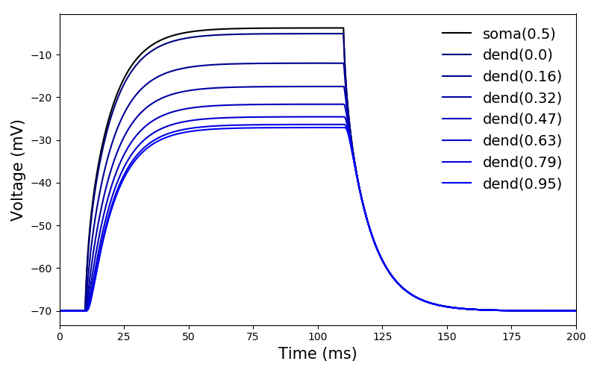
Ball and Stick model - forward propagation in steady state
################
# Plot Results #
################
plt.figure(figsize=(8,5))
plt.plot(t, soma_v,color='k',label='soma(0.5)')
for i,v in list(enumerate(dend_vs))[::3]:
plt.plot(t, v, color=(0,0,0.5+0.5*i/len(dend_vs)),
label = 'dend({:.2})'.format(i/len(dend_vs)))
Soma
Dendrite
R_{s}
R_{d0}
R_{d3}
Notes:
Exercise:
Inject current to the other end of the cable to location 1 of dend and plot the voltage in different location on the dendrite and soma

Slide 25
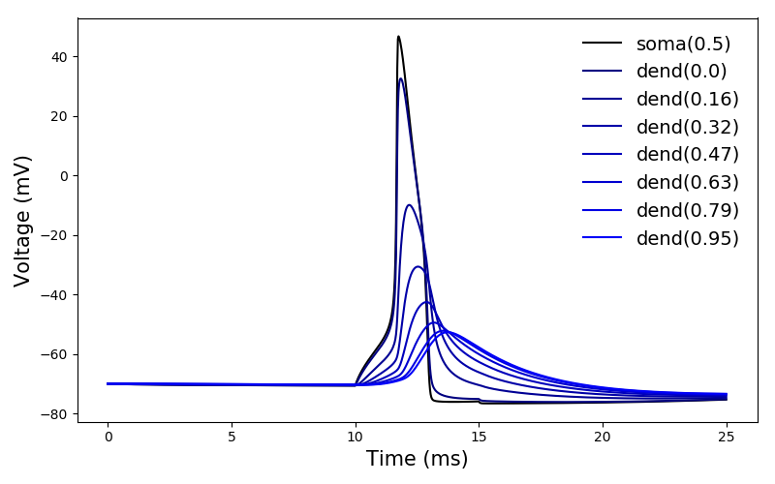
Ball and Stick model - backward propagation
###########################
# Add HH channels to soma #
###########################
h.tstop = 25
stim.dur = 5
soma.insert('kv') # add potassium channel
soma.gbar_kv = 2000 # set the potassium conductance
soma.insert('na') # add sodium channel
soma.gbar_na = 10000 # set the sodium conductance
h.celsius = 30
Soma
Dendrite
R_{s}
R_{d0}
R_{d3}

Slide 26
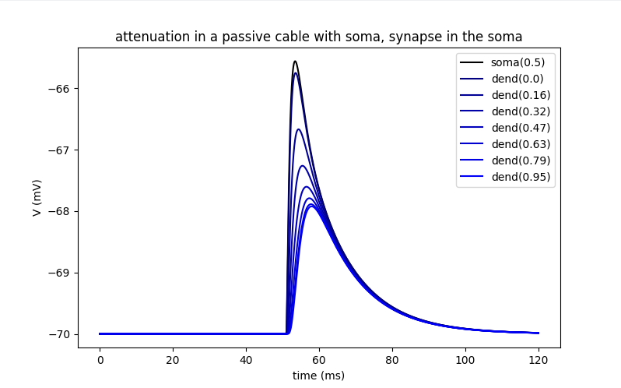
Ball and Stick model - backward propagation of synapse
go back to the synapse simulation and change the location of the synapse to the soma.
(slides 19-20), change:
synapse = h.Exp2Syn(dend(1))
to:
synapse = h.Exp2Syn(soma(0.5))
and run.
what is the difference from back/forward attenuation?
why?
Soma
Dendrite
R_{s}
R_{d0}
R_{d3}
Notes:
in the soma the input resistance will be lower, so less voltage in te injection position.
there is no capacitance sink in the end, so the voltage is in no rush to go throw the cable.

Slide 27
replication of results from papers

Slide 28
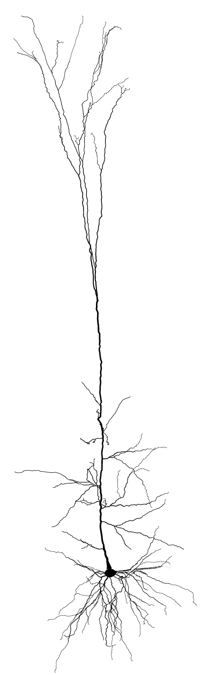
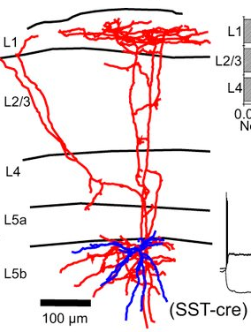
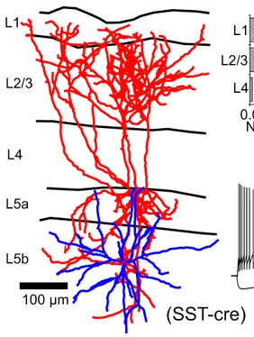
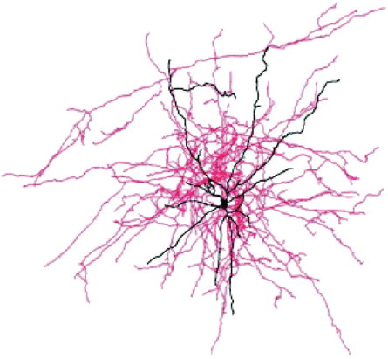
Inhibition location
paper 1
Pyramidal cell
Martionti cells (SST+)
Basket cells (PV+)

Slide 29
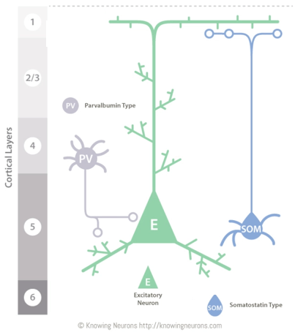
Inhibition location
paper 1

Slide 30
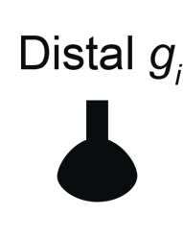

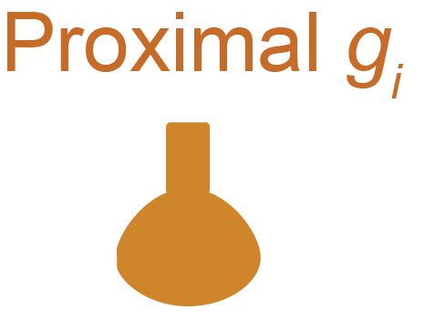

Inhibition location
paper 1

Slide 31
Inhibition location:
paper 1
###################
# # Build Model # #
###################
v_rest = -60 # the baseline voltage.
soma = h.Section(name="soma")
soma.L = 7
soma.diam = 7
soma.Ra = 100
soma.insert('pas')
soma.g_pas = 1/20000
soma.e_pas = v_rest
soma.insert('na') # insert active conductances to the soma.
soma.gbar_na = 5000 # set the Na conductance
soma.insert('kv')
soma.gbar_kv = 1500 # set the K conductance
h.celsius = 30
dend = h.Section(name="dend")
dend.L = 700
dend.diam = 1
dend.Ra = 100
dend.insert('pas')
dend.e_pas = v_rest
dend.g_pas = 1/20000
dend.connect(soma, 1, 0) #connect the end of the soma to the start of the dendrite
##@@ set number of segement!!!!
h("forall { nseg = int((L/(0.1*lambda_f(100))+0.9)/2)*2 + 1 }")

Slide 32
Inhibition location:
paper 1
#Now we create 20 AMPA_NMDA synapses:
hotspot_NMDA_synapses = []
hotspot_NMDA_netcons = []
hotspot_NMDA_netstims = []
for j in range(20):
hotspot_NMDA_synapses.append(h.ProbAMPANMDA2_RATIO(dend(0.6)))
hotspot_NMDA_netstims.append(h.NetStim())
hotspot_NMDA_netcons.append(h.NetCon(hotspot_NMDA_netstims[j], hotspot_NMDA_synapses[j]))
hotspot_NMDA_synapses[j].tau_r_AMPA = 0.33 # AMPA rise time
hotspot_NMDA_synapses[j].tau_d_AMPA = 1 # AMPA decay time
hotspot_NMDA_synapses[j].e=0
hotspot_NMDA_synapses[j].tau_r_NMDA = 0.23 # NMDA rise time
hotspot_NMDA_synapses[j].tau_d_NMDA = 55 # NMDA decay time
hotspot_NMDA_netcons[j].weight[0]= 0.5 # strength of the synapse – !The conductance!
hotspot_NMDA_netstims[j].number = 9e9 # number of synaptic activation
hotspot_NMDA_netstims[j].noise = 1 # randomness
hotspot_NMDA_netstims[j].interval = 50 # mean time between spikes |50 ms = 20 Hz|

Slide 33
Inhibition location:
paper 1
#########################
# # Set up experiment # #
#########################
#create one inhibitory synapse at location 0.2
on_path_inhibition = h.Exp2Syn(dend(0.2))
on_path_inhibition.tau1 = 0.01
on_path_inhibition.tau2 = 9e9
on_path_inhibition.e = v_rest # This value is what sets the synapse to be inhibitory
#create one inhibitory synapse at location 0.99
off_path_inhibition = h.Exp2Syn(dend(0.99))
off_path_inhibition.tau1 = 0.01
off_path_inhibition.tau2 = 9e9
off_path_inhibition.e = v_rest
#create a NetStim that will activate the synapses at t=1000
inhibition_netstim = h.NetStim() # the location of the NetStim does not matter
inhibition_netstim.number = 1
inhibition_netstim.start = 1000
inhibition_netstim.noise = 0
on_path_netcon = h.NetCon(inhibition_netstim, on_path_inhibition)
off_path_netcon = h.NetCon(inhibition_netstim, off_path_inhibition)

Slide 34
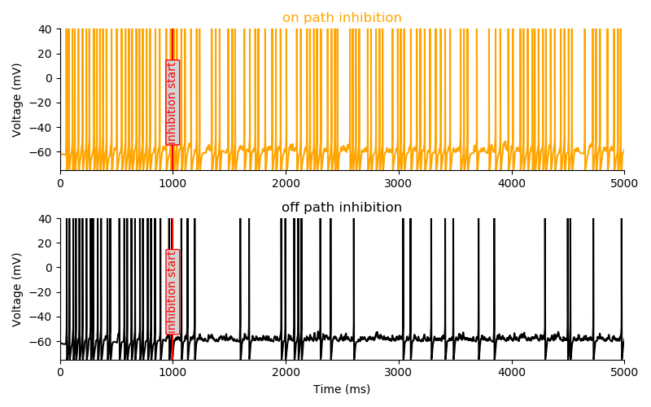
Inhibition location:
paper 1
#@ set up recording #@
###########################################
# Run simulation with proximal inhibition #
###########################################
inhibition_weight = 0.0025
on_path_netcon.weight[0] = inhibition_weight # activate the on_path synapse
off_path_netcon.weight[0] = 0 # deactivate the off path synapse by changing its conductance to 0
h.run()
soma_v_proximal_inh = list(soma_v)
##########################################
# Run simulation with distal inhibition #
##########################################
on_path_netcon.weight[0] = 0 # deactivate the on path synapse by changing its conductance to 0
off_path_netcon.weight[0] = inhibition_weight # activate only the on_path synapse
h.run()
soma_v_distal_inh = list(soma_v)
Principles Governing the Operation of Synaptic Inhibition in Dendrites
Albert Gidon and Idan Segev, Neuron, 2012
Notes:
Exercise:
Repeat the experiment, but replace the constant inhibition with 20 synapses that fire at 20 hz risetime 0.2 decaytime 2.4 find the right conductance

Slide 35
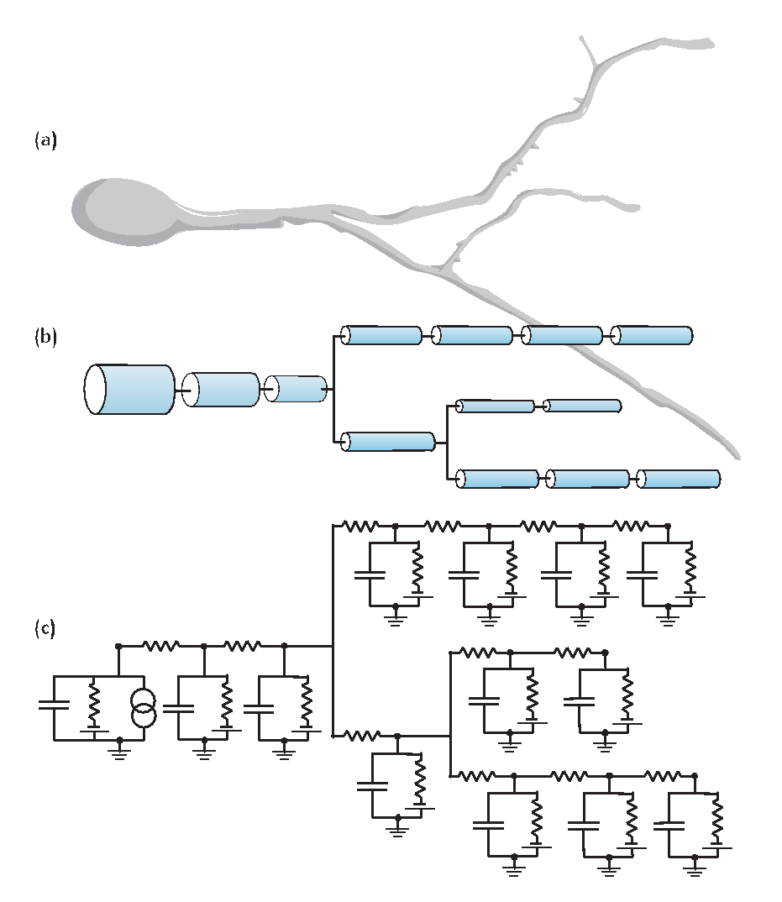
paper 2

Slide 36
Layer 5b Pyramidal Cell
paper 2
from neuron import h
##=================== creating cell object ==========
h.load_file("import3d.hoc")
morphology_file = "morphologies/cell1.asc"
h.load_file("models/L5PCbiophys3.hoc")
h.load_file("models/L5PCtemplate.hoc")
L5PC = h.L5PCtemplate(morphology_file)
1
##==================== recording settings ==============
t = h.Vector()
t.record(h._ref_t)
soma_v = h.Vector()
soma_v.record(L5PC.soma[0](0.5)._ref_v)
nexus_v = h.Vector()
nexus_v.record(L5PC.apic[36](0.9)._ref_v)
stim_current = h.Vector()
stim_current.record(stim._ref_i)
##==================== run simulation ============
h.v_init = -80
h.tstop = 1500
h.celsius = 37
h.run()
1
3
##==================== stimulus settings ======
stim = h.IClamp(L5PC.soma[0](0.5))
stim.dur = 1000
stim.delay = 400
stim.amp = 0.793
2
3
2
Models of Neocortical Layer 5b Pyramidal Cells Capturing a Wide Range of Dendritic and Perisomatic Active Properties
Etay Hay , Sean Hill, Felix Schürmann, Henry Markram, Idan Segev. PLOS Computational Biology 2011

Slide 37
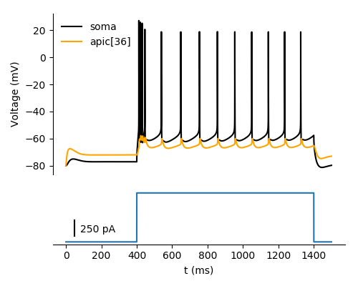

Layer 5b Pyramidal Cell
paper 2

Slide 38
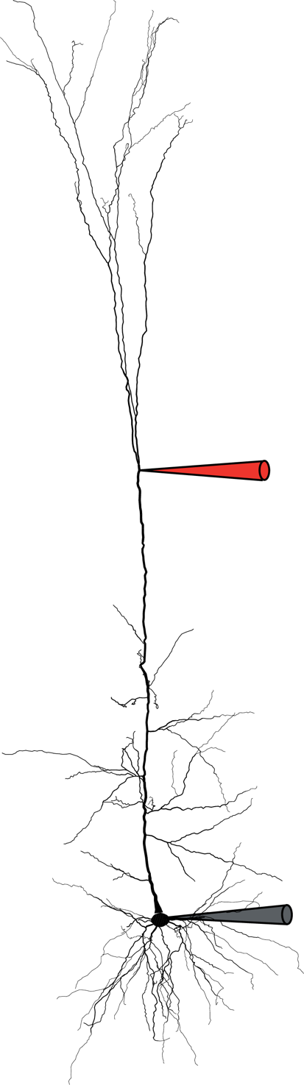
Layer 5b Pyramidal Cell – calcium spike
paper 2
##==================== stimulus settings ============
stim = h.IClamp(0.5, sec=L5PC.soma[0])
stim.dur = 5
stim.delay = 150
stim_current = h.Vector()
stim_current.record(stim._ref_i)
syn = h.epsp(L5PC.apic[36](0.9))
syn.tau0 = 0.5 #rise time
syn.tau1 = 5 #decay time
syn.onset = stim.delay + 5
syn_current = h.Vector()
syn_current.record(syn._ref_i)

Slide 39
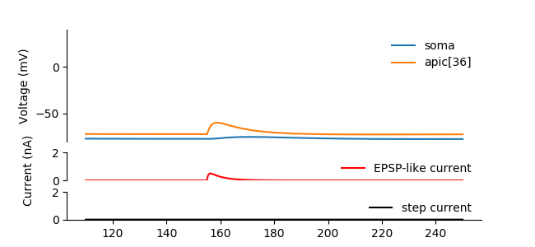
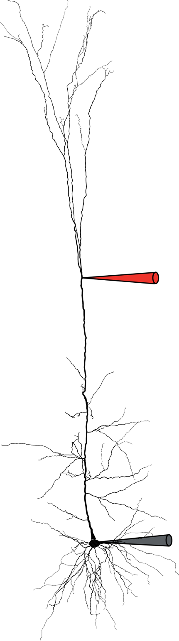
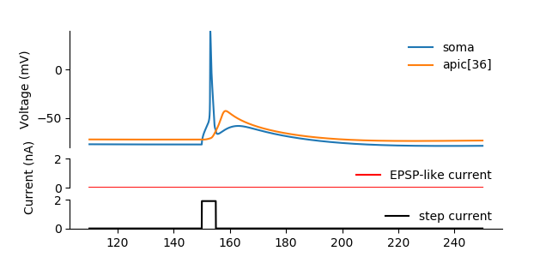
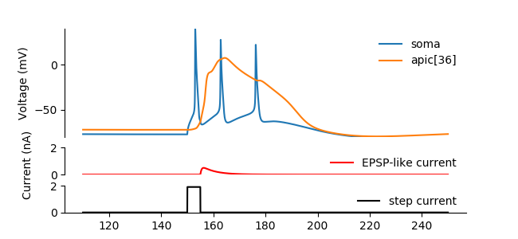

paper 2
# Only EPSP-like current
syn.imax = 0.5
stim.amp = 0
h.run()
plot_result(...)
# Only small step current
syn.imax = 0
stim.amp = 1.9
h.run()
plot_result(...)
Recording
# both step and EPSP-like currents
syn.imax = 0.5
stim.amp = 1.9
h.run()
plot_result(...)
Models of Neocortical Layer 5b Pyramidal Cells Capturing a Wide Range of Dendritic and Perisomatic Active Properties
Etay Hay , Sean Hill, Felix Schürmann, Henry Markram, Idan Segev. PLOS Computational Biology 2011
Notes:
Exercise:
Add a synapse to a random location on the neuron (use the GUI) and check what is the epsp that is creates.
Add more synapses to a random locations on the neuron (use the GUI) and check how many synapses are needed to make the neuron fire a spike

Slide 40
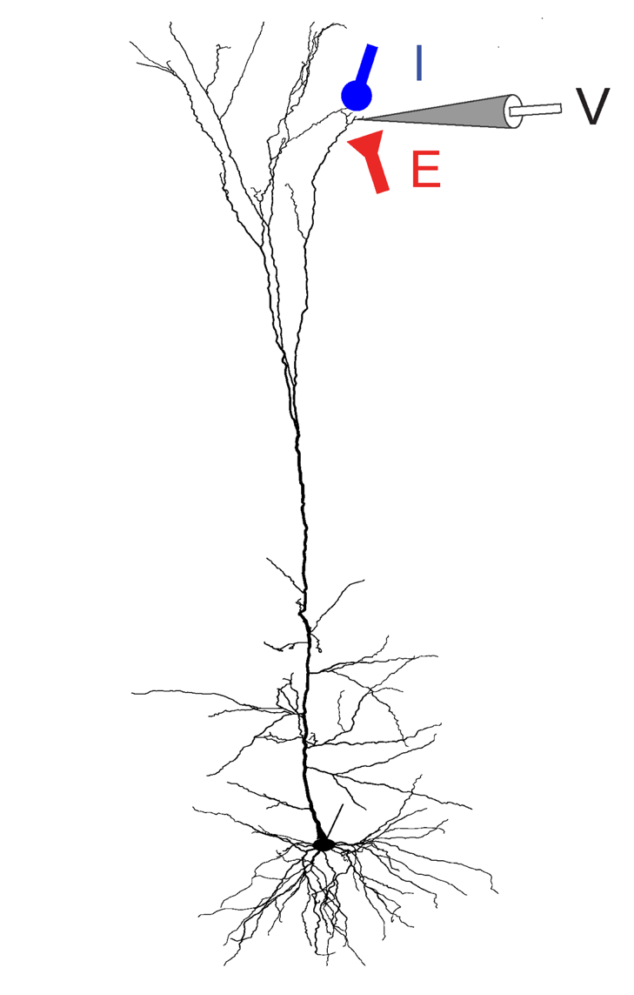
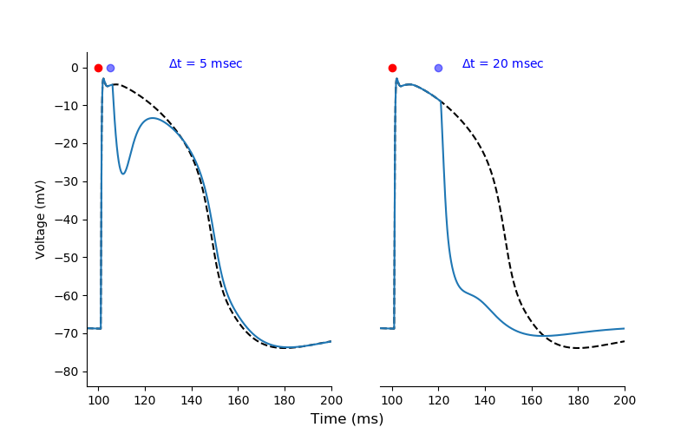
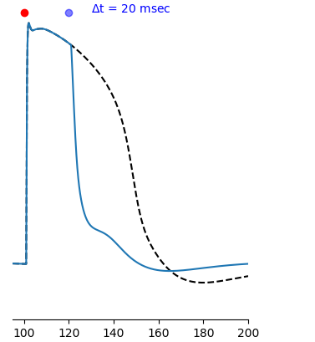
Timed inhibition
paper 3
3
Timed Synaptic Inhibition Shapes NMDA Spikes, Influencing Local Dendritic Processing and Global I/O Properties of Cortical Neurons
Michael Doron, Giuseppe Chindemi, Eilif Muller, Henry Markram, Idan Segev. Cell Reports 2017

Slide 41
fitting model to real data results
Notes:
how do we make our model to react in the same way realty does?

Slide 42
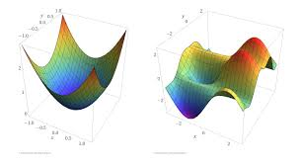
fitting model to real data results - problem definitions
in order to fit the model the first thing we need is a goal.
what do we want the model to do? replicate spike times? have the same passive properties? etc.
for start we will take the case we want to have the same passive properties (Rm, Ra, Cm).
next we find our constrain from the data => for now it will be the I-V traces and a short pulse of injection in the soma.
now we can define an error function we will try to minimize, such as the difference of the minimum of the I-V traces and the graphs of the short pulse.
we will show a Gradient descent aproce for fitting, pay attention that we do that if we can assume the cell is passive so the error function is concave (we can linearize it), in other cases other algorithms will be needed.
Notes:
how do we make our model to react in the same way realty does?

Slide 43
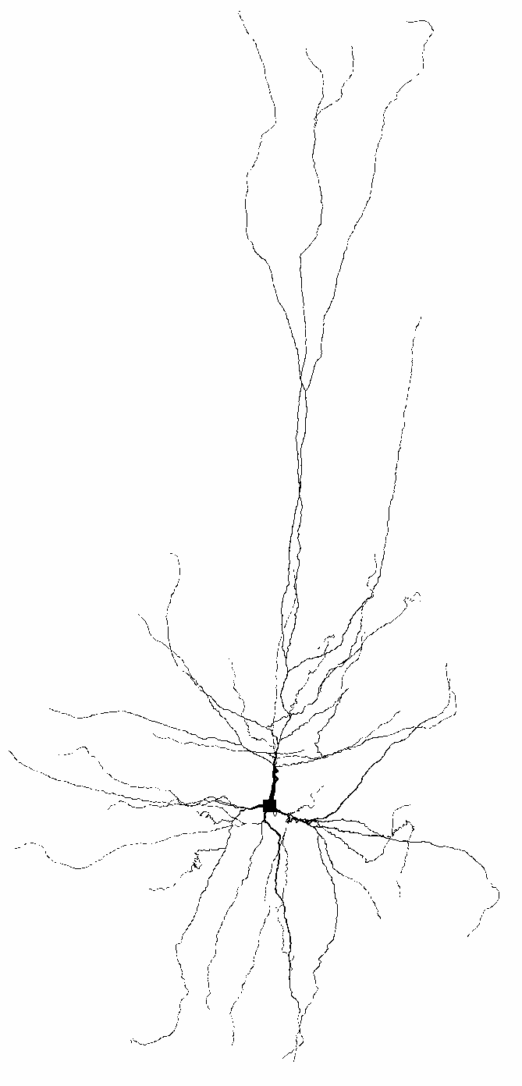
fitting model to real data results - setting the model
#we use a hoc template in order to load the morphology
from neuron import h, gui
post_morph_dir = "morph.swc"
h.load_file("import3d.hoc")
h.load_file("nrngui.hoc")
h("objref cell, tobj")
morph_file = post_morph_dir
model_file = "template_model"
model_path = ""
h.load_file(model_file + ".hoc")
h.execute("cell = new " + model_file + "()")
nl = h.Import3d_SWC_read()
nl.quiet = 1
nl.input(morph_file)
imprt = h.Import3d_GUI(nl, 0)
imprt.instantiate(h.cell)
cell = h.cell
cell.geom_nseg()
cell.delete_axon()
cell.biophys()
#inserting passive mechanism
for sec in postCell.all:
sec.insert("pas")

Slide 44
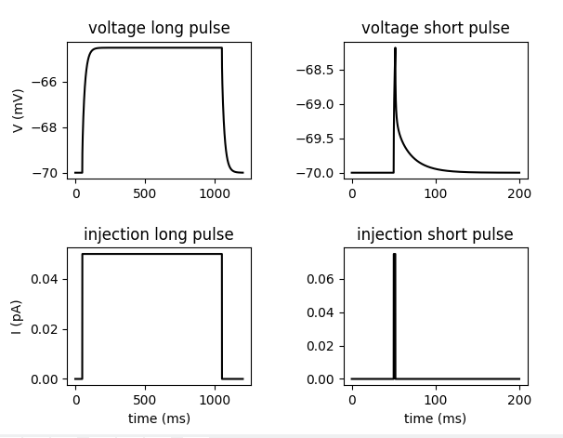
fitting model to real data results - load the data
######################################
# load the data and see what we have
######################################
long_pulse = "long_pulse.txt"
M1 = np.loadtxt(long_pulse)
M1[:,1] -= M1[:,1][0]
inj1, inj1_start, inj1_end = get_inj(M1[:,0], M1[:,1], M1[:,2])
E_PAS1 = np.mean(M1[:,2][:200]) # get e pas as the mean of the start of the trace
short_pulse = "short_pulse.txt"
M2 = np.loadtxt(short_pulse)
E_PAS2 = np.median(M2[:,2][:200]) # get e pas as the mean of the start of the trace
inj2, inj2_start, inj2_end = get_inj(M2[:,0], M2[:,1], M2[:,2])
#plotting
fig, ax = plt.subplots(2,2)
plt.subplots_adjust(hspace = 0.5, wspace = 0.5)
ax[0][0].set_title("voltage long pulse")
ax[0][0].plot(M1[:,0], M1[:,2], color="k")
ax[1][0].set_title("injection long pulse")
ax[1][0].plot(M1[:,0], M1[:,1], color="k")
ax[0][1].set_title("voltage short pulse")
ax[0][1].plot(M2[:,0], M2[:,2], color="k")
ax[1][1].set_title("injection short pulse")
ax[1][1].plot(M2[:,0], M2[:,1], color="k")
ax[0][0].set_ylabel("V (mV)")
ax[1][0].set_ylabel("I (pA)")
ax[1][1].set_xlabel("time (ms)")
ax[1][0].set_xlabel("time (ms)")
plt.show()
Notes:
function in next slide

Slide 45
fitting model to real data results -
setting some helper functions
# function to find the data we need from the traces
def get_inj(T,I,V):
I_abs = np.abs(I)
inj_start = np.where(I_abs > I_abs.max() / 4.0)[0][0]
inj_end = np.where(I_abs > I_abs.max() / 4.0)[0][-1]
inj = np.median(I[inj_start:inj_end]) / 1000.0
return inj, T[inj_start], T[inj_end]
#some constants
F_factor = 1.5
SPINE_START = 60
# function to set the model parameters in the fitting
def change_model_pas(CM=1, RA = 250, RM = 20000.0, E_PAS = -70):
h.distance(0, sec=cell.soma[0])
for sec in cell.all:
sec.Ra = RA
sec.cm = CM
sec.g_pas = 1.0 / RM
sec.e_pas = E_PAS
for sec in cell.basal:
for seg in sec:
if h.distance(seg.x) > SPINE_START:
seg.cm *= F_factor
seg.g_pas *= F_factor
for sec in cell.apic:
for seg in sec:
if h.distance(seg.x) > SPINE_START:
seg.cm *= F_factor
seg.g_pas *= F_factor
cell.soma[0].Ra=RA
cell.soma[0].cm=CM
cell.soma[0].g_pas=1.0 / RM
cell.soma[0].e_pas = E_PAS

Slide 46
fitting model to real data results -
setting some helper functions
# function to plot in the end
def plot_res(RM, RA, CM, save_name= "fit"):
change_model_pas(CM=CM, RA=RA, RM=RM, E_PAS = E_PAS1)
clamp.amp = inj1
clamp.dur = inj1_end - inj1_start
clamp.delay = inj1_start
Vvec1 = h.Vector()
Vvec1.record(soma(0.5)._ref_v)
h.tstop = M1[:,0][-1]
h.v_init=E_PAS1
h.run()
npVec1 = np.array(Vvec1)
plt.plot(M1[:,0], M1[:,2], color = 'k')
time = np.arange(0,len(npVec1) * h.dt,h.dt)
plt.plot(time, npVec1, color = 'r', linestyle ="--")
plt.title("long pulse fit")
plt.savefig(save_name+"_long.png")
plt.savefig(save_name+"_long.pdf")
plt.close()
change_model_pas(CM=CM, RA=RA, RM=RM, E_PAS = E_PAS2)
clamp.amp = inj2
clamp.dur = inj2_end - inj2_start
clamp.delay = inj2_start
Vvec2 = h.Vector()
Vvec2.record(soma(0.5)._ref_v)
h.tstop = M2[:,0][-1]
h.v_init=E_PAS2
h.run()
npVec2 = np.array(Vvec2)
plt.plot(M2[:,0], M2[:,2], color = 'k')
time = np.arange(0,len(npVec2) * h.dt,h.dt)
plt.plot(time, npVec2, color = 'r', linestyle ="--")
plt.xlabel("time (ms)")
plt.ylabel("V (mv)")
plt.title("short pulse fit")
plt.savefig(save_name+"_short.png")
plt.savefig(save_name+"_short.pdf")
plt.close()

Slide 47
fitting model to real data results -
setting the objective function
# objective function
def efun(vals):
if RM_IX != -1 :
if vals.x[RM_IX] > 100000:
return (1e6)
RM = vals.x[RM_IX]
else: RM = 25000
if CM_IX != -1:
if vals.x[CM_IX] > 2 :
return (1e6)
CM = vals.x[CM_IX]
else:CM = 1
if RA_IX != -1:
if vals.x[RA_IX] > 350:
return (1e6)
RA = vals.x[RA_IX]
else:RA = RA
if (CM < 0.3 or RM < 5000 or RA < 100):
return 1e6
change_model_pas(CM=CM, RA=RA, RM = RM, E_PAS = E_PAS1)
clamp.amp = inj1
clamp.dur = inj1_end - inj1_start
clamp.delay = inj1_start
Vvec1 = h.Vector()
Vvec1.record(soma(0.5)._ref_v)
h.v_init=E_PAS1
h.tstop = M1[:,0][-1]
h.run()
npVec1 = np.array(Vvec1)
error_1 = abs(npVec1.max()- M1[:,2].max()) # change to min if the injection is negative
change_model_pas(CM=CM, RA=RA, RM = RM, E_PAS = E_PAS2)
clamp.amp = inj2
clamp.dur = inj2_end - inj2_start
clamp.delay = inj2_start
Vvec2 = h.Vector()
Vvec2.record(soma(0.5)._ref_v)
exp_data = M2[:,2]
h.v_init=E_PAS2
h.tstop = M2[:,0][-1]
h.run()
npVec2 = np.array(Vvec2)
fit_start_for_short_pulse = int((inj2_end+1)/h.dt)
exp_data_fit_part = exp_data[fit_start_for_short_pulse:fit_start_for_short_pulse+int(100/h.dt)]
sim_data_fit_part = npVec2[fit_start_for_short_pulse:fit_start_for_short_pulse+int(100/h.dt)]
# mean square error
error_2 = np.sum(np.sqrt(np.power(exp_data_fit_part - sim_data_fit_part, 2)))
print("cur error =", error_1 + error_2," RM=" , RM, " RA=", RA, " CM=" , CM)
return error_1 + error_2

Slide 48
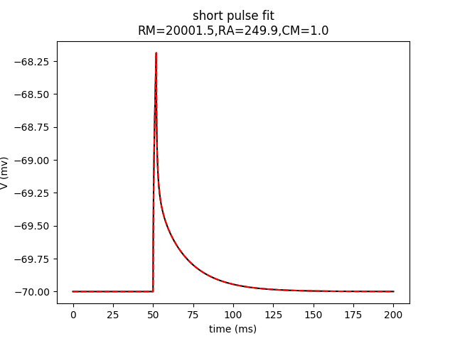
fitting model to real data results -
running the fit
CM_IX = 0
RM_IX=1
RA_IX = 2
RM_const = 20000.0
RA_const = 250.0
CM_const = 1.0
print("free params:")
h.attr_praxis(1e-9,1000,0)
opt_vals = h.Vector(3)
opt_vals.x[RM_IX] =22000.0
opt_vals.x[RA_IX] = 200
opt_vals.x[CM_IX] = 1
for i in range(3):
RMSD = h.fit_praxis(efun,opt_vals)
RM = opt_vals.x[RM_IX]
RA = opt_vals.x[RA_IX]
CM = opt_vals.x[CM_IX]
print("RMSD", RMSD,", RM", RM, ", RA", RA, ", CM", CM)
plot_res(CM=CM, RM=RM, RA = RA, save_name="_fit_after_"+str(i+1))
import pickle
pickle.dump({"RMSD":RMSD,"RM":RM, "RA":RA, "CM":CM}, open(""))
the “real” values are:
RM = 20000.0
RA = 250
CM = 1
Notes:
how far can we start the fitting in order to converge?

Slide 49
summary
Basic use of NEURON
Single compartment model
Active conductances
cable model and attenuation.
Ball and stick model
Synaptic activation
Full complex multi-compartmental model
fitting for passive model parameter with gradient descent

